Slide 1

Accenture North-America Data Analysis Program

Slide 2


Today's agenda
Project recap
Problem
The Analytics team
Process
Insights
Summary

Slide 3

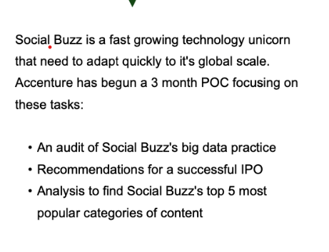

Project Recap

Slide 4

Problem
Over 100000 post per day
3650000 pieces of content
per year
But how to capitalize on it when its so much?
Analysis to find Social Buzz’s top 5 most popular categories of content.

Slide 5



Andrew Fleming
[Chief Technical Architect]
The Analytics team
Marcus Rompton
[Senior Principle]
Ruchika Sawant
[Data Analyst]

Slide 6

Process
1
Data Understanding
2
Data Cleaning
3
Data Modelling
4
Data Analysis
5
Uncover Insights

Slide 7
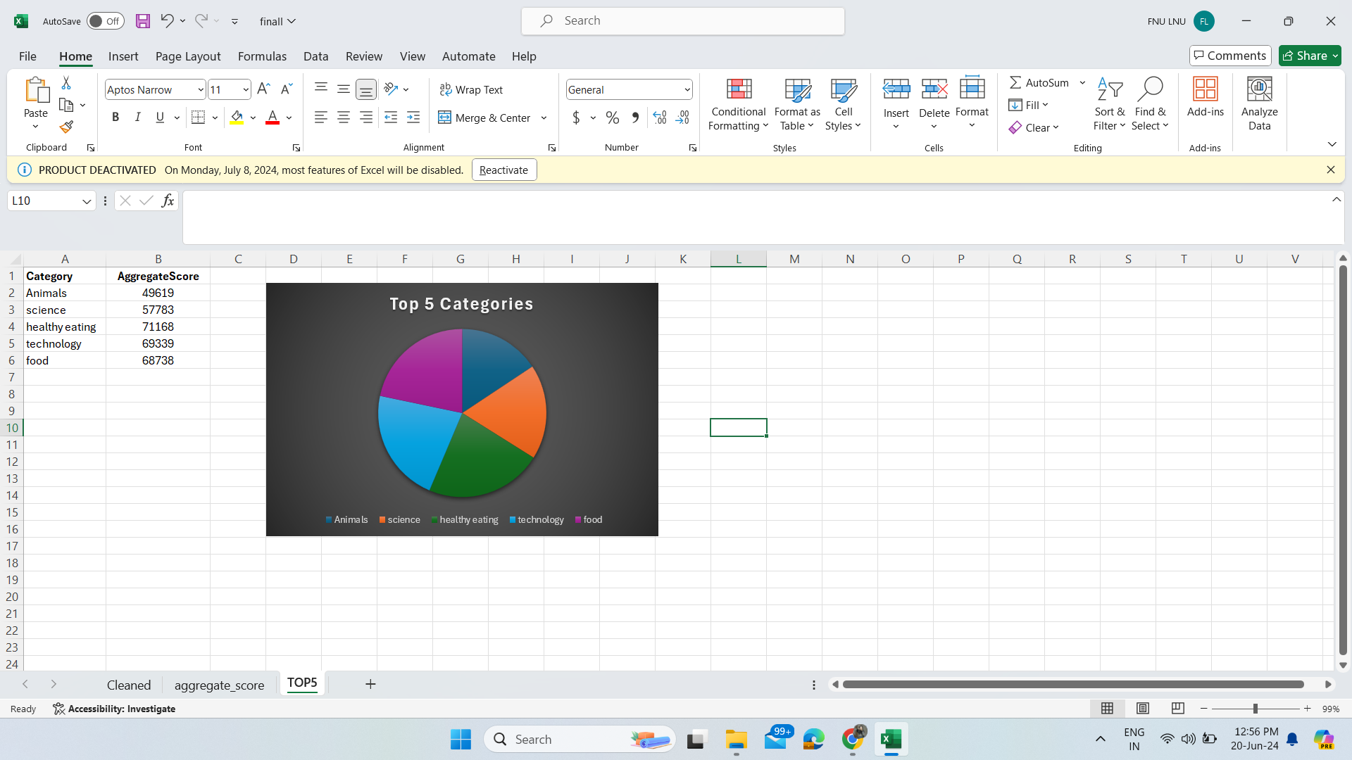

Insights
Top 5 Categories

Slide 8
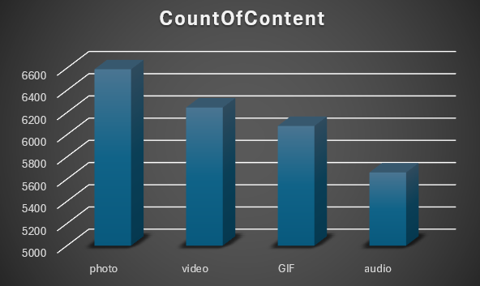
Total Count of Content

Slide 9
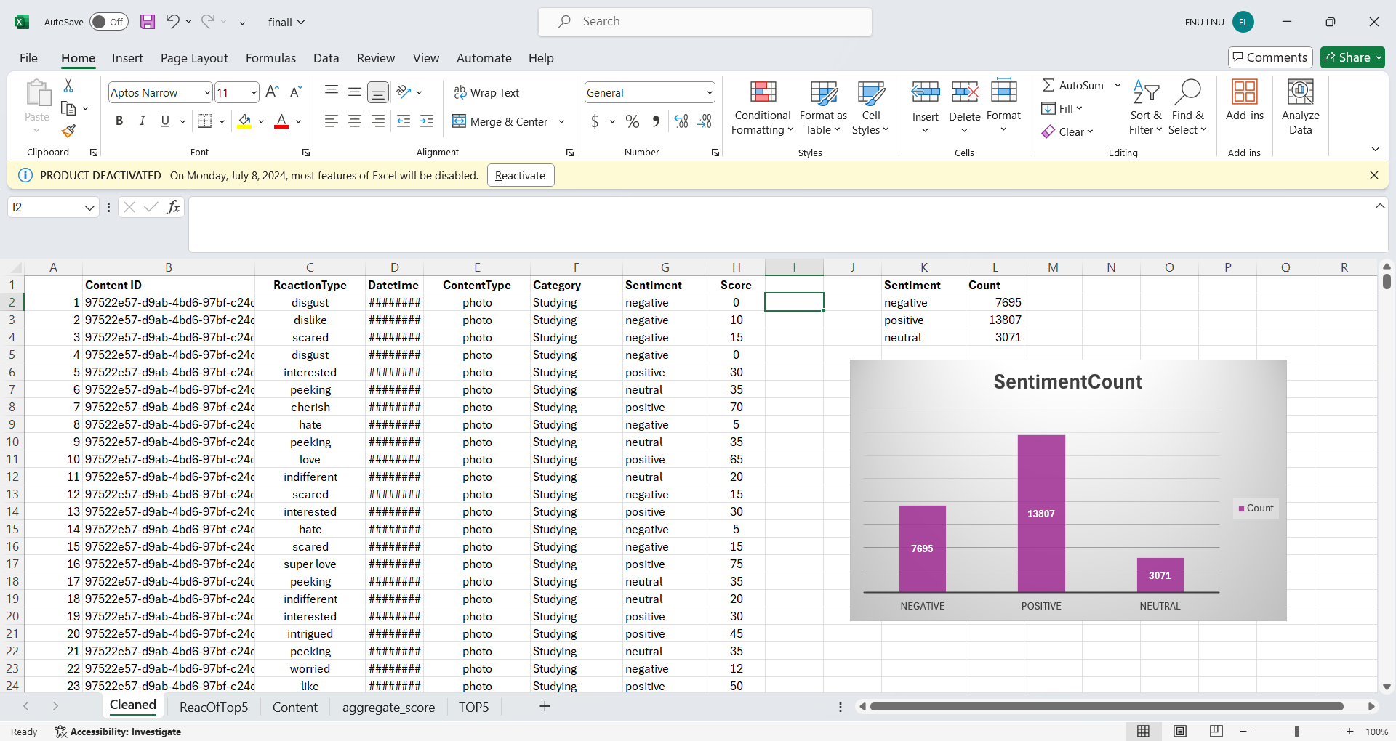
Total Count of Sentiment

Slide 10

Total 4 types of content are there: Photo, video, GIF and Audio and the most preferred content type are photo and video simultaneously.
Top 5 most popular categories are animal, science, healthy eating, technology, food.
There are 16 unique categories and animal is the most favorite category.
Sentiment types are Positive, Negative, Neutral and the sentiment with most count is Positive sentiment with 13807 count.
Summary

Slide 11
Thank you!
ANY QUESTIONS?

